Slide 1
5(Five)S

Slide 2
Session objectives
By the end of this session, participants will be able to:
Describe the steps for each of the Five S (5S) components
Mention the importance of 5S
List examples of 5S activities in Kenya

Slide 3
5S
is…
a philosophy
a way of organizing the workspace and work flow with the intent to improve efficiency of work
5S is a management tool, used as a systematic approach for productivity, quality and safety improvement in all types of organizations

Slide 4
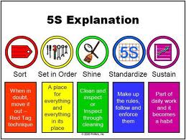
Components of 5S
5S is an abbreviation for five terms:
Sort (Sasambua)
Set (Seti)
Shine (Safisha)
Standardize (Sanifisha)
Sustain (Shikilia)

Slide 5
Sort (Sasambua)
Clear/discard unwanted items in offices, workplace, homes.
Irrelevant items
Unwanted structures
Unwanted items on shelves, tables, drawers
Store (keep)“may be needed” items
Regular sorting of unused items
Develop culture of returning items to where they belong

Slide 6
Sort (Sasambua)
Need it
Materials/ Items
Classification
May not need it
Not need it

Slide 7
Red Tags – used in sort (s1)
5S RED TAG
Dept./Unit………………..
Tagged date……………..By…………
Date of Re-check…………By………..
□Necessary □ May be necessary
□Unnecessary
Where to keep………………..

Slide 8
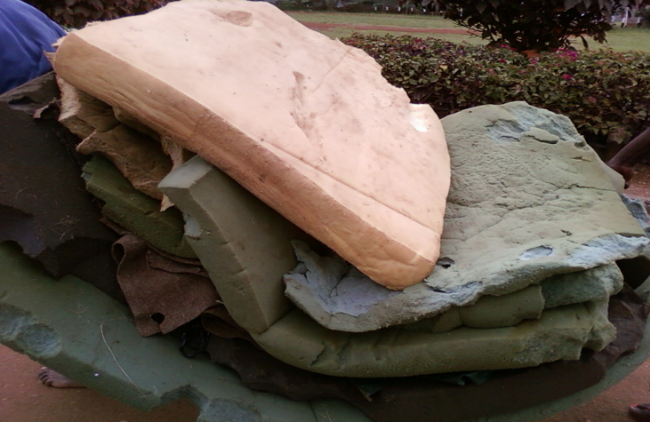
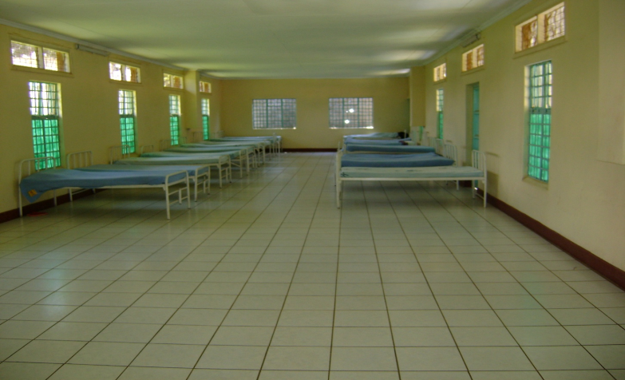
Sorting in a ward
Don’t need it
Don’t need it
Sorted

Slide 9
Set (Seti)
Orderliness, systematize to organize all necessary items in easy services provision
Organize left-over items
Organize layout of drugs, tools and equipment in best order for convenience of operation
Designated locations.
Availability at point of use.
Directional boards to all facilities and Service points
Identification labels for rooms, toilets etc.

Slide 10
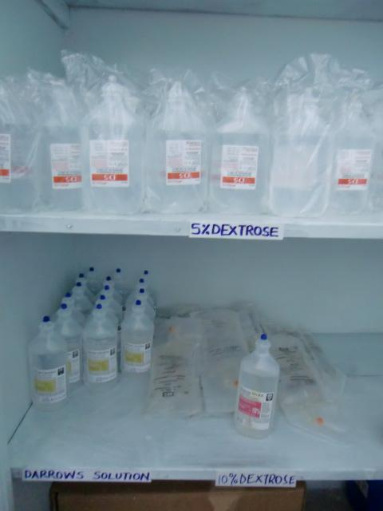
Set (Seti)
Alignment
Labelling
For easy access to stored items

Slide 11
Shine (Safisha)
Cleanliness and beautifying
Daily self cleaning
No dust on floors, tables, shelves, walls and machines
Adequate cleaning tools/detergents
Provision of waste bins
Equipment, buildings, compound maintenance

Slide 12
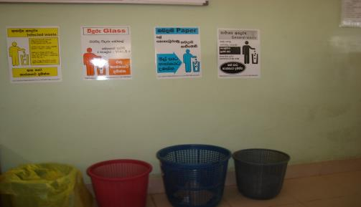
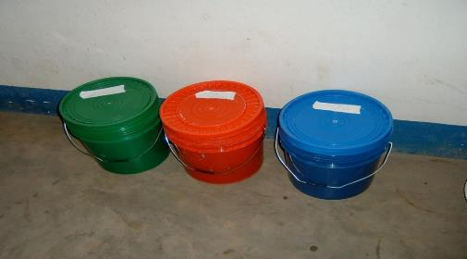
Shine (Safisha)
Cleanliness and beautifying
Provision of waste bins

Slide 13
Standardize (Sanifisha)
Evidence of Sort, Set and Shine all around
Standard Operating Procedures (SOPs)
Orderliness in the use of corridors
Storage of files, records and work venues standardized
Transparency e.g. glass covers on cupboards
Danger warning signs
Fire extinguisher signs
Exit signs
Electrical switch labels

Slide 14
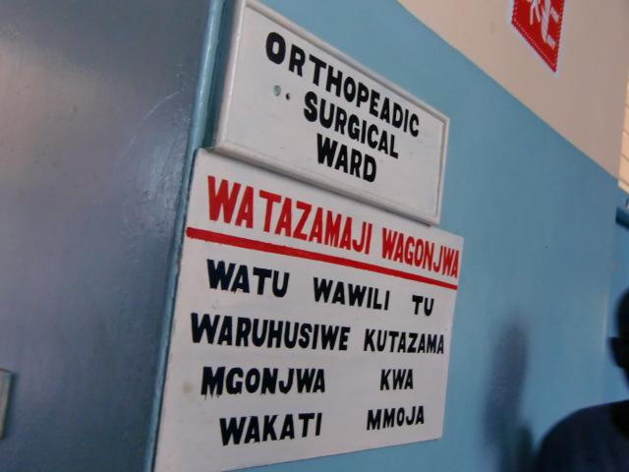
Standardize(Sanifisha)
Direction Signs
To show location of places and facilities in hospitals
Safety Signs
Attention to hazardous items
Guides visitors and workers

Slide 15
Sustain (Shikilia)
Self discipline
Train staff to follow good work habits
Strict observation of workplace rules
Regular training programmes for all categories of employee
5S Group activities
Self discipline among visitors to the institution
Language used in the hospital
Professional ethics – dignity, confidentiality.
Use of PDSA Cycle

Slide 16
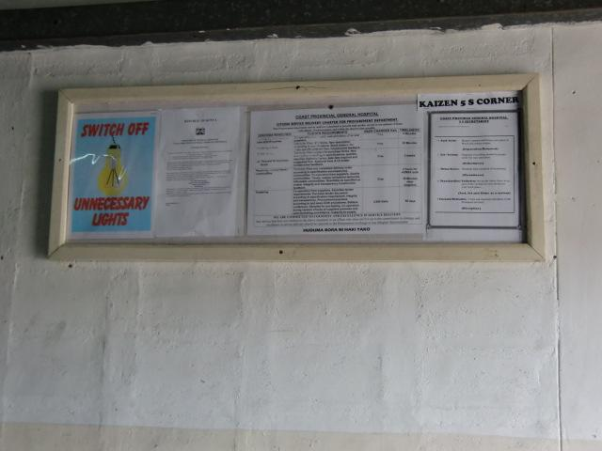
Sustain (Shikilia)
5-S Corner
May use existing notice boards
Establish new notice boards

Slide 17
Importance of 5S
The workplace gets cleaned and better organized
Hospital and office operations become easier and safer
Results are visible to everyone; insider and outsiders
Visible results enhance the generation of more and new ideas
People will be proud about their clean and organized workplace
As a result the health facilities good image generates more business
People spend half their time at work place looking for things!

Slide 18
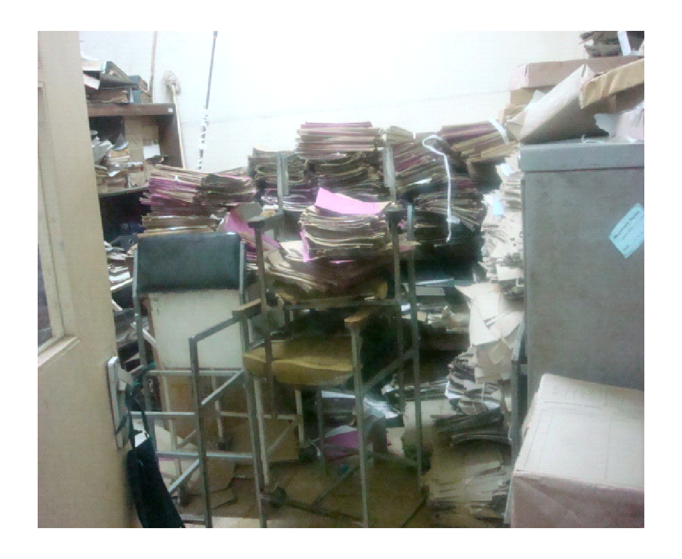
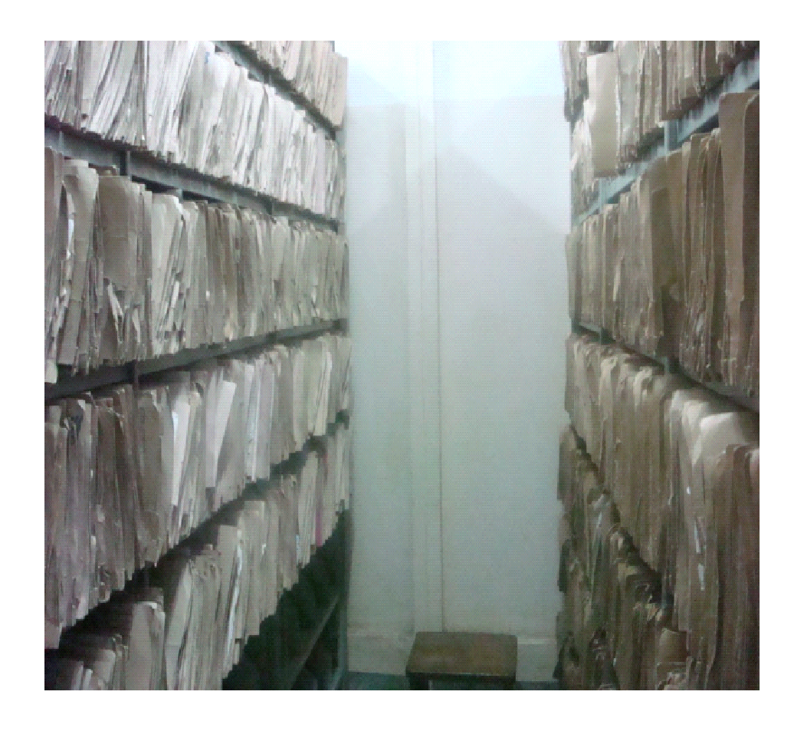
Examples of 5S activities in Kenya (1)
Medical records room
After 5S
Before 5S

Slide 19
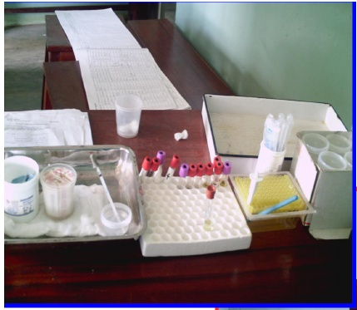
Examples of 5S Activities in Kenya (2) HIV Counseling and Testing room
After 5S
Before 5S

Slide 20
Medicine Cupboard
BEFORE 5S
AFTER 5S

Slide 21
Linen Store
BEFORE 5S
AFTER 5S

Slide 22
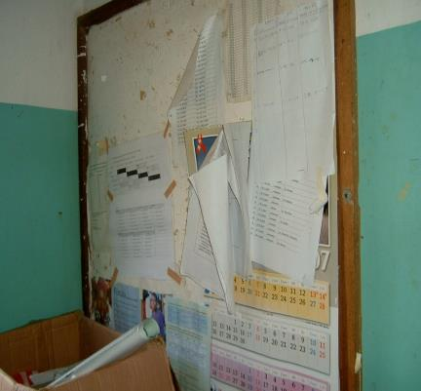
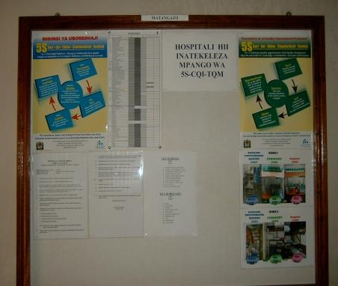
Bulletin Board
BEFORE 5S
AFTER 5S
Orderliness, beautification, poster display (X-Y axis)
Remove old, out dated posters, calendars, notices regularly from N/Boards…..Tidiness

Slide 23
5. X–Y AXIS – USED IN S2
Orderliness, beautification, poster display
Remove old, out dated posters, calendars, notices regularly from N/Boards…..Tidiness
Well arranged board following X-Y axis
X Poorly arranged N/Board

Slide 24
LETS ALL PRACTISE 5S ....YEEEEEH!!!!

Slide 25
Key points
This session focused on:
Identifying components and steps of 5S
Highlighting the importance of 5S with examples

Slide 26
THANK YOU
info@ampathkenya.org | www.ampathkenya.org | @ampathkenya

